Slide 1


The proxy inventory Applications : French implementation
7-9 October 2025 - Sarajevo

Slide 2
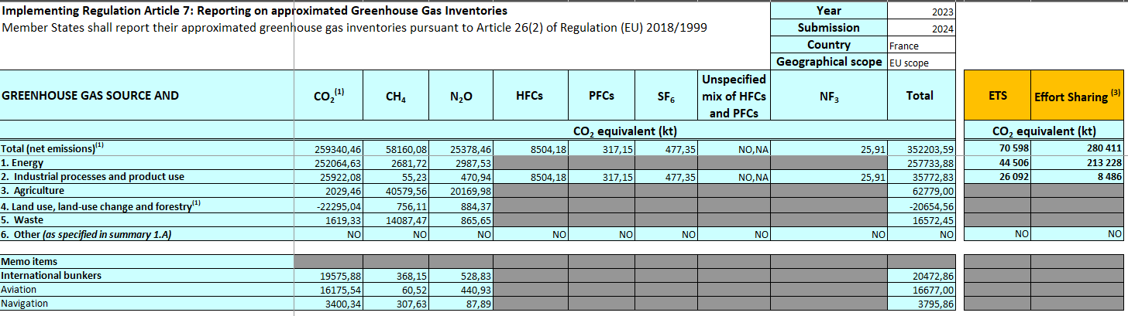
2023 French proxy results
Results by sector and gas
Notes:
Based on previous inventory – 2024 proxy is not available yet

Slide 3
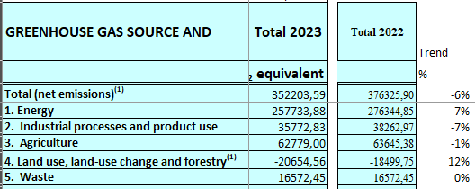

2023 French proxy results
Evolution with 2022 (last inventoried year)
Notes:
Based on previous inventory – 2024 proxy is not available yet

Slide 4
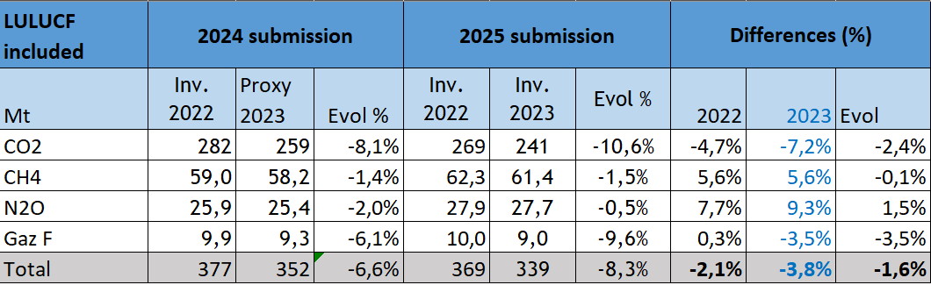
2023 French proxy against real inventory
Differences explanations (GHGI 2023 vs proxy 2023)
Higher uncertainties of proxy estimates VS NGHGI
Not all the sectors have specific trend proxy estimates
Recalculations between editions/submissions
 Proxy in continous improvement
Notes:
2023 proxy improvements :
1- Air transport indicator splited into national/international (and by fuel)
2- Proxy in agriculture implemented
3- a few other indicators modified or added

Slide 5
2023 French proxy : available proxy data
Electricity production
Bottum-up by plant for energy consumptions by fuel and CO₂ emissions
Calculation
CO₂ 2023 emissions → Total from electricity plants
Other gases:
→ E₂₀₂₃ = total₂₀₂₃ energy consumption by fuel x EF₂₀₂₂ by fuel
Refineries
Bottum-up by plant for CO₂ emissions
Calculation
CO₂ 2023 emissions → Total from refineries
Other gases:
→ E₂₀₂₃ = Activity₂₀₂₂ x CO₂ emission trend_{(2023/2022)} x EF₂₀₂₂

Slide 6
2023 French proxy: available proxy data
Road transport
2023 Consumption by fuel (annual and monthly)
2023 Vehicle fleet (annual)
2023 Specific proxy EF calculated (annuel)
Calculation
→Use of COPERT model

Slide 7
2023 French proxy: available indicators
Buildings
Consumptions for some fuel of the sector (or close sector)
Calculation
→ E₂₀₂₃ = Activity₂₀₂₂ x Fuel consumption trend_{(23/22)} x EF₂₀₂₂
Combustion in industry
Consumptions for some fuel by industry size (big/small)
Calculation
→ E₂₀₂₃ = Activity₂₀₂₂ x Fuel consumption trend_{(23/22)} x EF₂₀₂₂

Slide 8
2023 French proxy: available indicators
IPPU
Production index (monthly) by industrial sector
Calculation
1. Index trend_{(2023/2022)} = 2023 Total 12 months / 2022 Total 12 months
2. E₂₀₂₃ = Activity₂₀₂₂ x Index trend_{(2023/2022)} x EF₂₀₂₂
Agriculture
Livestock
Crops
Calculation
Specific proxy estimates using the GHGI agriculture emission model

Slide 9

2023 French proxy: no available data
Waste
Calculation
E₂₀₂₃ = E₂₀₂₂
Major part of LULUCF
. Calculation
E₂₀₂₃ = E₂₀₂₂
. Except 2023 proxy estimates for forest fire using the statistical indicator of burned forest areas

Slide 10

Extending annual proxy to monthly estimates French emission barometer during current year X
Similar general method but with monthly indicators VS annual indicator
If no indicator: annual proxy emissions (X-1) with temporal profiles or divided by 12.
National inventory relative to (X-2) emissions (edition X)
Proxy inventory relative to (X-1) emissions (edition X)
Indicators by month
relative to (X-1 and X) in current year X
Proxy split by month => monthly emissions (X-1) year
Trend of indicators by month
X-1 -> X
Trends applied on proxy
Emissions by sector and month of the current year X
X = current year
Notes:
2023 proxy improvements :
1- Air transport indicator splited into national/international (and by fuel)
2- Proxy in agriculture implemented
3- a few other indicators modified or added

Slide 11
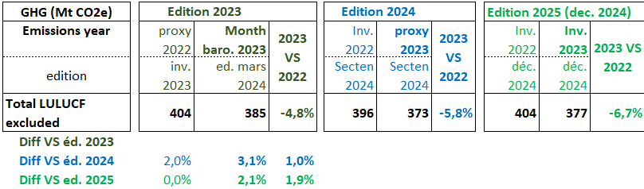
How reliable are the monthly pre-estimations ?
Differences explanations (2023: NGHI vs Proxy vs Barometer)
Uncertainties of monthly barometer > proxy > NGHGI
Not all sectors specifically estimated in the baro/proxy
Recalculations between editions (3 different editions)
Significant improvement of the proxy in 2024 edition (aviation, agriculture,…)
Notes:
2023 proxy improvements :
1- Air transport indicator splited into national/international (and by fuel)
2- Proxy in agriculture implemented
3- a few other indicators modified or added

Slide 12

Citepa is an association that guides players in the ecological transition in France and around the world.
It assesses the impact of human activities on climate and air pollution. It produces reference data and develops solutions to encourage action to reduce emissions, improve air quality and adapt to climate change.
Our multidisciplinary team contributes to building a sustainable world.
Thank you for your attention
Jean-pierre.chang@citepa.org
Ariane.druart@citepa.org
42 rue de Paradis 75010 Paris
0033 144 836 883
infos@citepa.org
citepa.org

